Slide 1
Natural Language Processing
Text Representations

Slide 2
Outline
Introduction
One-Hot Encoding
Bag of Words
Count Vectorizer
TF – IDF
N-Gram
Occurrence Matrix & Co-Occurrence Matrix

Slide 3
Introduction
Computers are brilliant when dealing with numbers.
They are faster than humans in calculations & decoding patterns.
But what if the data is not numerical?
What if it's language?
What happens when the data is in characters, words & sentences?
How do we make computers process our language?
How we represent words as input for all the NLP tasks.
How we represent meaning of words as input for all the NLP tasks.

Slide 4
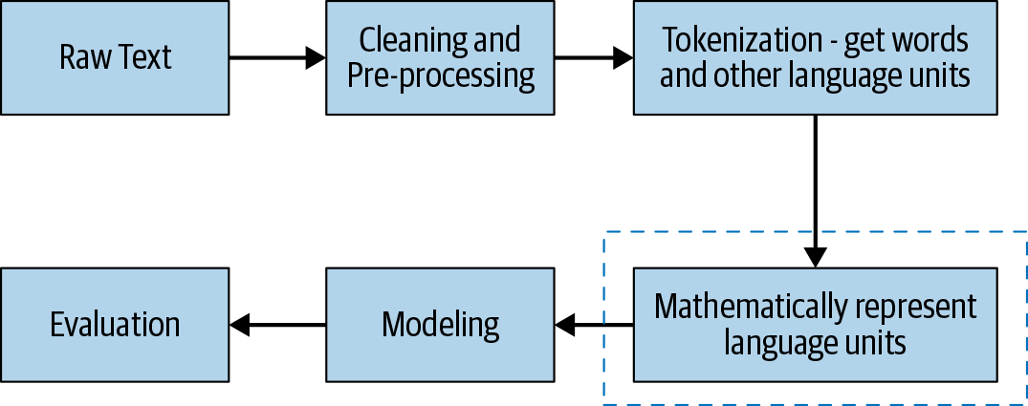
Introduction
Text Representation the essential step that is important for most NLP tasks.
Text Representation is the conversion of text into numbers (vectors) for machines to understand and decode patterns within a language.
Text representation plays an important role in defining features for machine and deep learning models.
There are many basic and advanced feature engineering (text to features) methods.
These methods vary from One-Hot vector to embedding techniques.

Slide 5
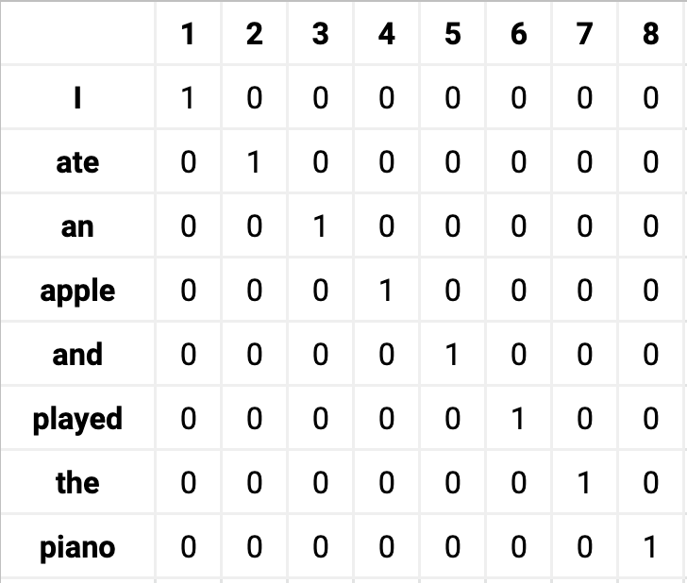
One-Hot Encoding
One-hot encoding is a vector representation of words in a “Vocabulary”.
Each word in the vocabulary is represented by a vector of size N where N is the total number of words in the vocabulary.
For instance, if a vocabulary contains 8 words, then the vector will have a size of 8.
The encoding of a given word is simply the vector in which the corresponding element is set to one, and all other elements are zero.

Slide 6
One-Hot Encoding (Limitations)
The curse of dimensionality, which refers to all sorts of problems that arise with data in high dimensions.
Most of the matrix is taken up by zeros, so useful data becomes sparse.
Imagine we have a vocabulary of 50,000.
Each word is represented with 49,999 zeros and a single one.
We need 50,000 squared = 2.5 billion units of memory space.

Slide 7
One-Hot Encoding (Limitations)
It is hard to extract meanings.
Each word is embedded in isolation from other words.
The resulting set of vectors do not say much about one another.
If our vocabulary had “orange,” “banana,” and “watermelon,” we can see the similarity between those words, such as the fact that they are types of fruit, or that they usually follow some form of the verb “eat.”
We can easily form a mental map or cluster where these words exist close to each other.
But with one-hot vectors, all words are equal distance apart:
There’s no meaningful comparison.
Context information is not utilized.
Does not consider the frequency of a word.

Slide 8
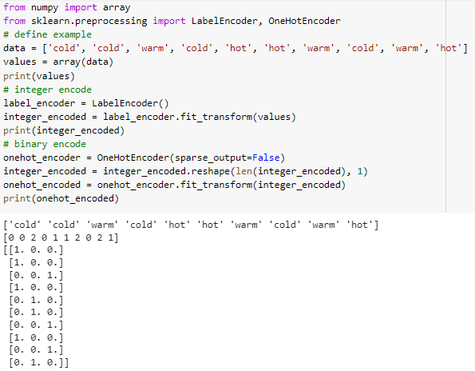
One-Hot Encoding (Example)

Slide 9
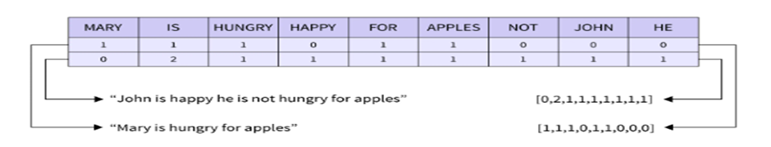
Bag of Words
A bag-of-words model, or BoW for short, is a way of extracting features from text for use in modeling, such as with machine learning algorithms.
A bag-of-words is a representation of text that describes the occurrence of words within a document. It involves two things:
A vocabulary of known words.
A measure of the presence of known words.
It is called a “bag” of words, because any information about the order or structure of words in the document is discarded.
The model is only concerned with whether known words appear in the document, not where in the document.

Slide 10
Bag of Words (Limitations)
Vocabulary:
The vocabulary requires careful design and applying some preprocessing tasks such as stop word removing, stemming and lemmatization.
Sparsity:
Sparse representations are harder to model both for computational reasons (space and time complexity) and for information reasons.
The challenge is for the models to harness so little information in such a large representational space.
Meaning:
Discarding word order ignores the context, and in turn meaning of words in the document (semantics).
Context and meaning can offer a lot to the model, that if modeled could tell the difference between the same words differently arranged (“this is interesting” vs “is this interesting”), synonyms (“old bike” vs “used bike”).

Slide 11
Count Vectorizer
On an elementary level, the bag of words is implemented using Count Vectorizer.
Count vectorizer is based on term frequencies and can squeeze an entire sentence or document into a single vector.
Each position of a count vector is assigned to a particular token and its value represents the number of appearances that token has in the sentence or document.
Tokens are first generated from the corpus and vocabulary is built to map the tokens to their corresponding IDs.
Instead of building one vector for each token, a count vector simply counts how many times each token appeared in a sentence or document and places that number in their corresponding position in the vector.
Hashing vectorizer is memory efficient, and instead of storing tokens as strings, the vectorizer applies the hashing trick (Hash Function) to encode them as numerical indexes.

Slide 12

TF-IDF
Term Frequency (TF) is how often a word appears in a document, divided by how many words there are.
TF(t) = (Number of times term t appears in a document) / (Total number of terms in the document)
Inverse Document Frequency (IDF) is how unique or rare a word is.
IDF(t) = log(Total number of documents / Number of documents with term t in it)
Hint: Some packages use another updated formula.
A High weight in TF-IDF is reached by a high term frequency(in the given document) and a low document frequency of the term in the whole collection of documents.
TF-IDF algorithm is made of 2 algorithms multiplied together.

Slide 13
TF-IDF (Example)
Consider a document containing 100 words wherein the word apple appears 5 times. The term frequency (i.e., TF) for apple is then (5 / 100) = 0.05.
Assume we have 10 million documents, and the word apple appears in one thousand of these. Then, the inverse document frequency (i.e., IDF) is calculated as log(10,000,000 / 1,000) = 4.
Thus, the TF-IDF weight is the product of these quantities: 0.05 * 4 = 0.20.

Slide 14
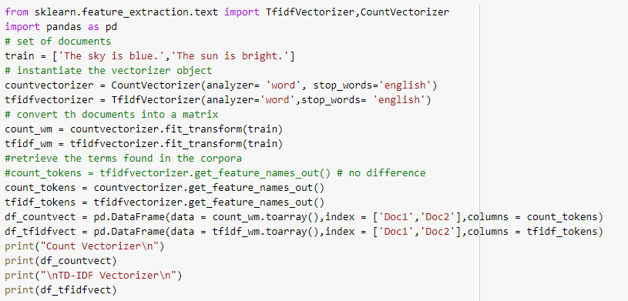
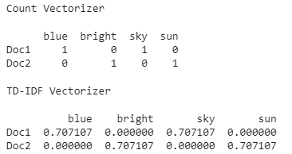
Count Vectorizer & TF-IDF (Example)

Slide 15
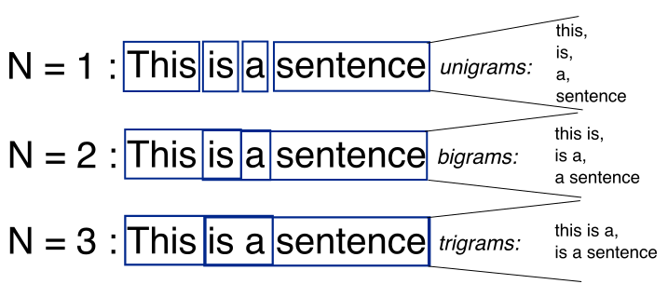
N-Gram
N-Gram representation is similar to the Count Vectorizer bag words model.
The only difference is that instead of calculating the frequency of one word we calculate the frequency of groups of words (in groups of two or more) occurring together in the corpus.
In this way, we get a better understanding of the text sequence.
Based on the number of words grouped together, the model has termed a bigram (2 words), trigram(3 words), and so on.

Slide 16
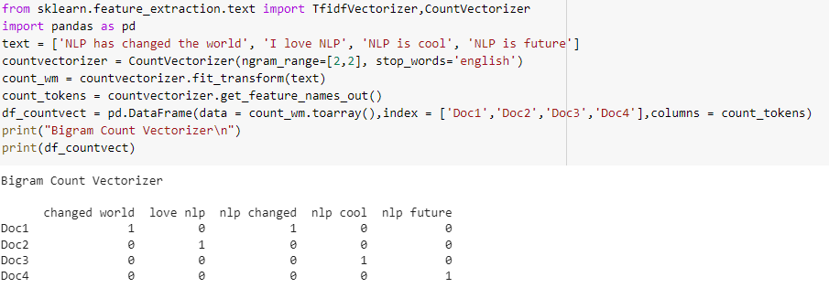
N-Gram

Slide 17
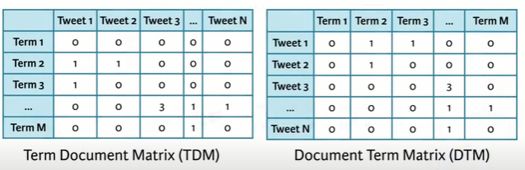
Occurrence Matrix & Co-Occurrence Matrix
Distributional Representations: “ A word can be identified by the company it keeps ”
Occurrence is the one which creates a matrix which has context on one axis (document, sentence, tweet, post) and terms (unique word with stop word removal i.e. Vocabulary ) on the other axis.
Occurrence matrix is also called Term-Document (Document-Term) Matrix.
Each cell contains 0/1 , the Frequency or the TF-IDF score.

Slide 18
Occurrence Matrix & Co-Occurrence Matrix
Unlike the Occurrence matrix which is a rectangular matrix, the Co-Occurrence matrix is a square matrix where it depicts the co-occurrence of two terms in a context.
The co-occurrence matrix is also called the Term-Term matrix.
It’s a square matrix as the it’s a matrix between each term and another term.
Co-Occurrence matrix can be constructed using two approaches:
Full Document : Two terms occur in the same document.
All sports terms will have similar entries.
Window: Two terms occur in the same window (Context).
Sliding a window with given size.
Captures both syntactic and semantic information.

Slide 19
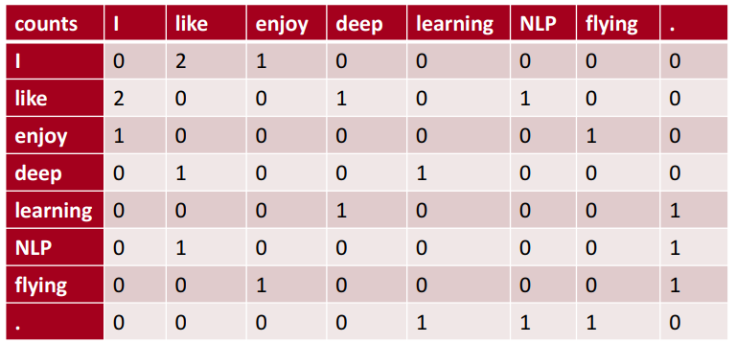
Occurrence Matrix & Co-Occurrence Matrix
Example corpus: (I like deep learning., I like NLP., I enjoy flying.)
Similar words tend to occur together and will have similar contexts
Window length 1 (more common: 3,5,7,9)
Symmetric:
(irrelevant whether left or right context)
Co-occurrences limitations:
Increase in size with vocabulary
Very high dimensional: require a lot of storage
Needs dimensionality reduction technique such as Singular Value Decomposition (SVD)
Hard to incorporate new words or documents

Slide 20


